Slide 1
Apache Hadoop and Spark: Introduction and Use Cases for Data Analysis
Afzal Godil
Information Access Division, ITL, NIST

Slide 2
Outline
Growth of big datasets
Introduction to Apache Hadoop and Spark for developing applications
Components of Hadoop, HDFS, MapReduce and HBase
Capabilities of Spark and the differences from a typical MapReduce solution
Some Spark use cases for data analysis

Slide 3
What is the difference between web server and Apache http server ?

Slide 4
Hadoop
A distributed system that breaks big problems into smaller parts, runs them in parallel on many machines, and tolerates failure automatically

Slide 5
Data
The Large Hadron Collider produces about 30 petabytes of data per year
Facebook’s data is growing at 8 petabytes per month
The New York stock exchange generates about 4 terabyte of data per day
YouTube had around 80 petabytes of storage in 2012
Internet Archive stores around 19 petabytes of data

Slide 6
Cloud and Distributed Computing
The second trend is pervasiveness of cloud-based storage and computational resources
For processing of these big datasets
Cloud characteristics
Provide a scalable standard environment
On-demand computing
Pay as you need
Dynamically scalable
Cheaper

Slide 7
Data Processing and Machine learning Methods
Data processing (third trend)
Traditional ETL (extract, transform, load)
Data Stores (HBase, ……..)
Tools for processing of streaming,
multimedia & batch data
Machine Learning (fourth trend)
Classification
Regression
Clustering
Collaborative filtering
Data Processing ETL (extract, transform, load)
Big Datasets
Machine
Learning
Distributed Computing
Working at the Intersection of these four trends is very exciting and challenging and require new ways to store and process Big Data

Slide 8
Hadoop Ecosystem
Enable Scalability
on commodity hardware
Handle Fault Tolerance
Can Handle a Variety of Data type
Text, Graph, Streaming Data, Images,…
Shared Environment
Provides Value
Cost

Slide 9
how does Hadoop vary from HDFS?

Slide 10
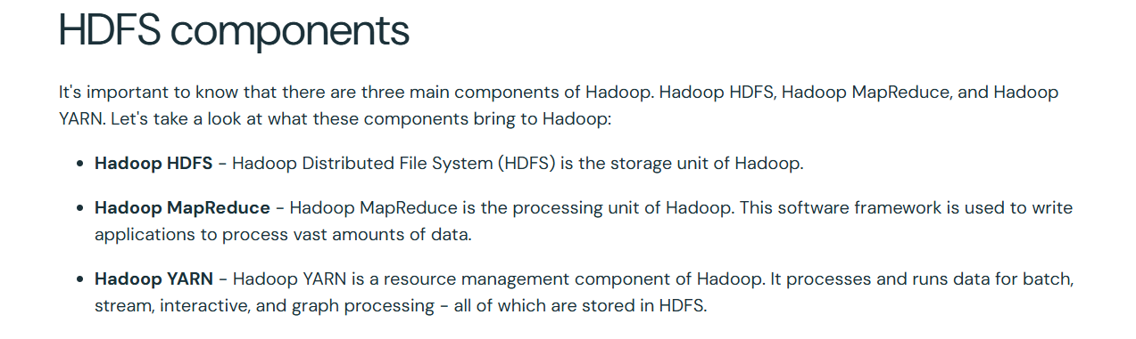

Slide 11
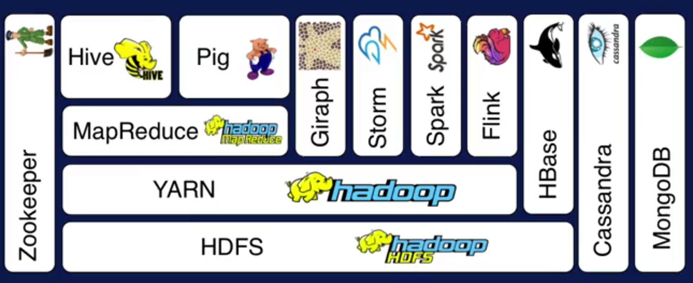
Hadoop Ecosystem
A
Layer Diagram
B
C
D

Slide 12
Apache Hadoop Basic Modules
Hadoop Common
Hadoop Distributed File System (HDFS)
Hadoop YARN
Hadoop MapReduce
Other Modules: Zookeeper, Impala, Oozie, etc.
Spark, Storm, Tez, etc.
HBase
Non-relational Database
Pig
Scripting
Hive
SQL Like Query
MapReduce
Distributed Processing
Others
Distributed Processing
Yarn
Resource Manager
HDFS Distributed File System (Storage)
Notes:
YARN is resource manager

Slide 13
Hadoop HDFS
Hadoop distributed File System (based on Google File System (GFS) paper, 2004)
Serves as the distributed file system for most tools in the Hadoop ecosystem
Scalability for large data sets
Reliability to cope with hardware failures
HDFS good for:
Large files
Streaming data
Not good for:
Lots of small files
Random access to files
Low latency access
Single Hadoop cluster with 5000 servers and 250 petabytes of data

Slide 14
Design of Hadoop Distributed File System (HDFS)
Master-Slave design
Master Node
Single NameNode for managing metadata
Slave Nodes
Multiple DataNodes for storing data
Other
Secondary NameNode as a backup

Slide 15
HDFS Architecture
NameNode keeps the metadata, the name, location and directory
DataNode provide storage for blocks of data
Client
NameNode
Secondary NameNode
DataNode
DataNode
DataNode
DataNode
DataNode
DataNode
DataNode
DataNode
Heartbeat, Cmd, Data

Slide 16
HDFS
What happens; if node(s) fail?
Replication of Blocks for fault tolerance
File
B1
B2
B3
B4
Node
Node
Node
Node
B1
B2
B4
B3
Node
Node
Node
Node
B1
B3
B1
B2
B4
Node
Node
Node
Node
B4
B3
B1
B2

Slide 17
HDFS
HDFS files are divided into blocks
It’s the basic unit of read/write
Default size is 64MB, could be larger (128MB)
Hence makes HDFS good for storing larger files
HDFS blocks are replicated multiple times
One block stored at multiple location, also at different racks (usually 3 times)
This makes HDFS storage fault tolerant and faster to read

Slide 18
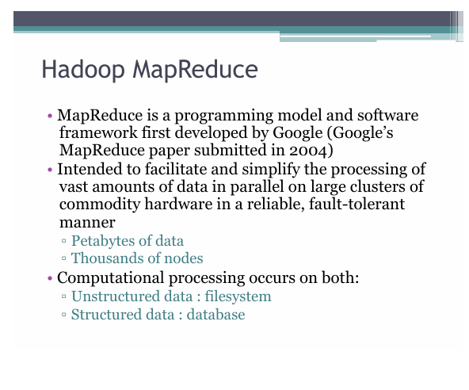

Slide 19
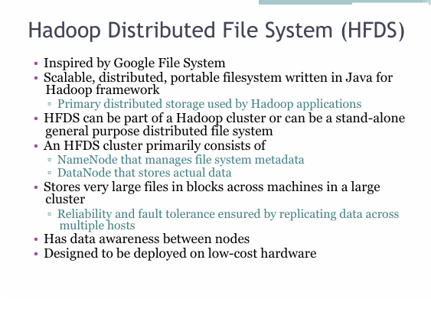

Slide 20
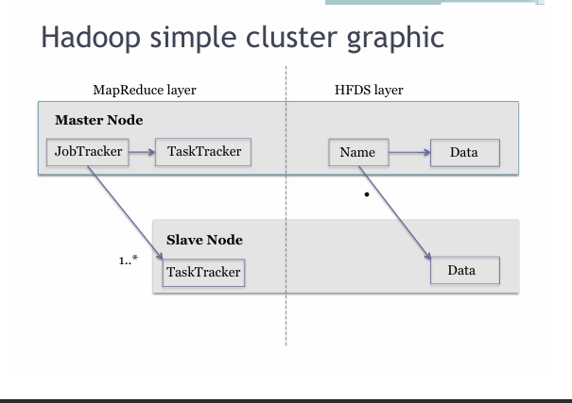



Slide 21
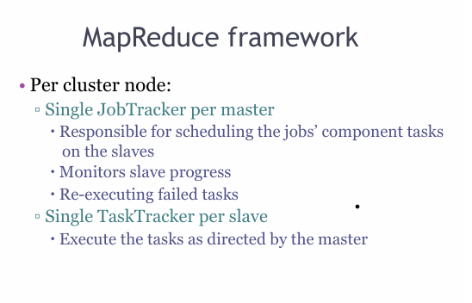

Slide 22
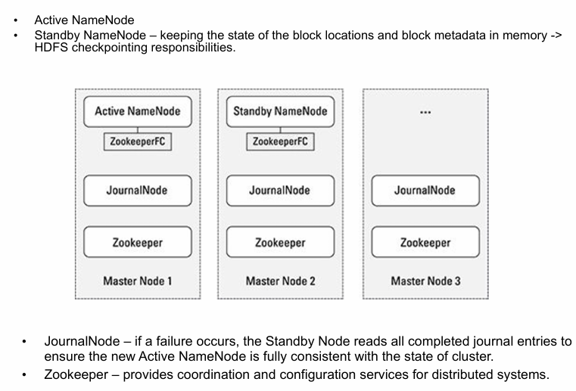

Slide 23
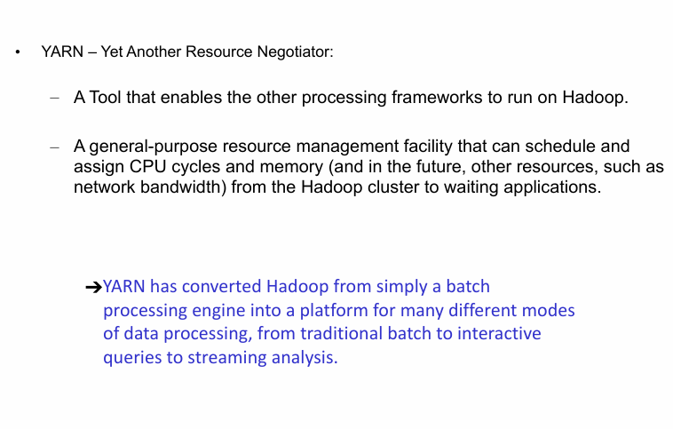

Slide 24
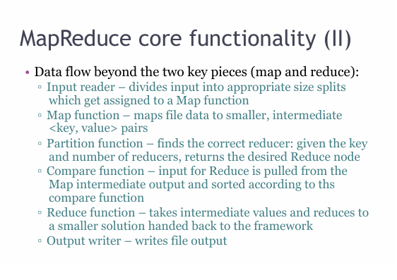

Slide 25
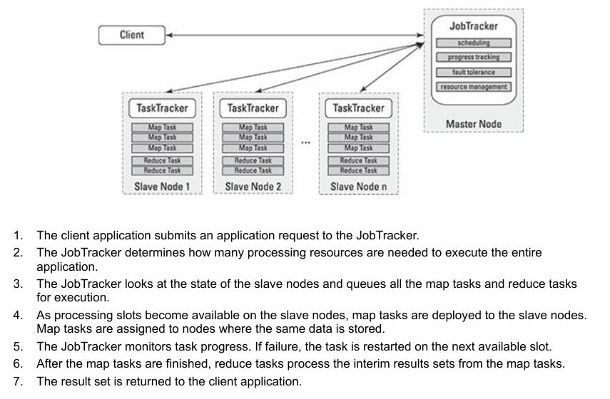
Hadoop Execution

Slide 26
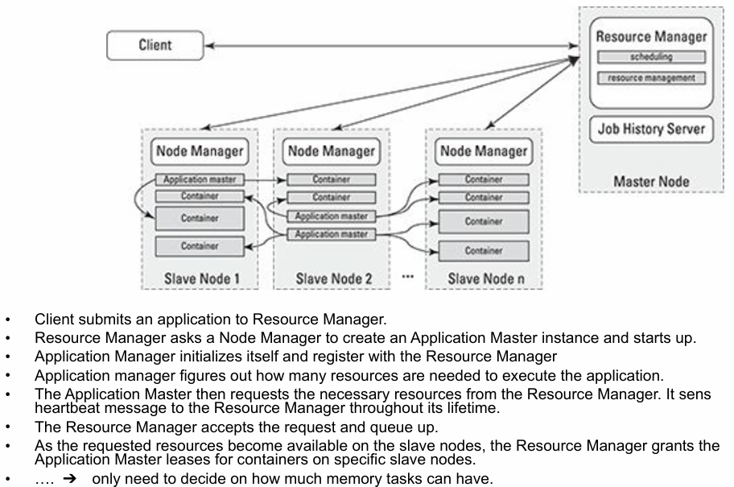
YARN’ Application execution

Slide 27
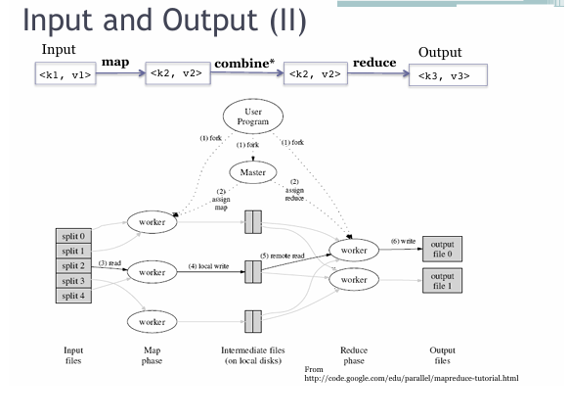

Slide 28
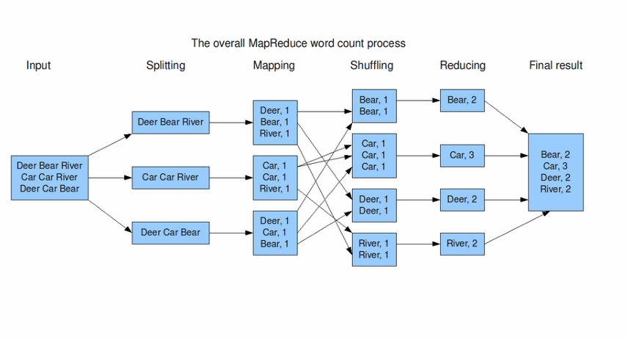
MapReduce Example

Slide 29
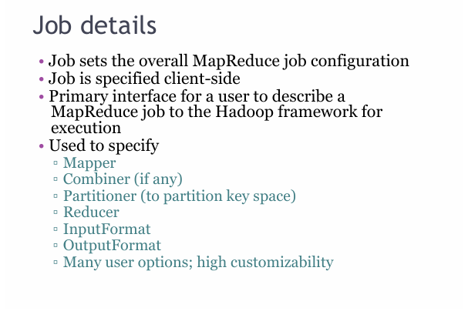

Slide 30
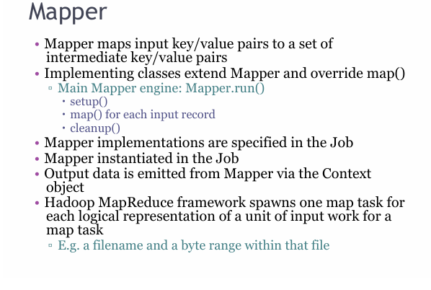

Slide 31
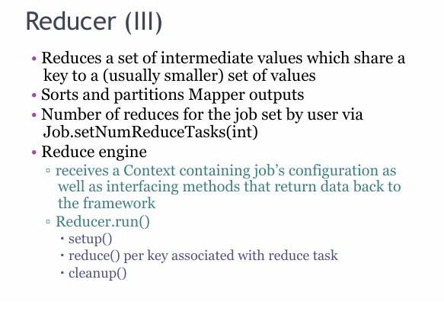

Slide 32
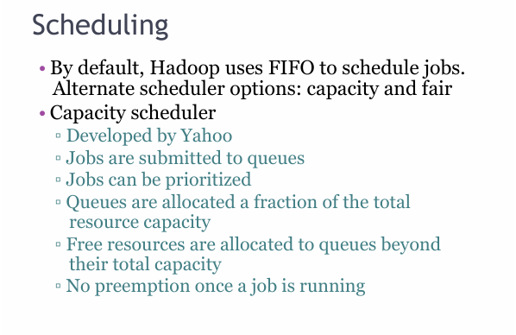

Slide 33
Few HDFS Shell commands
Create a directory in HDFS
hadoop fs -mkdir /user/godil/dir1
List the content of a directory
hadoop fs -ls /user/godil
Upload and download a file in HDFS
hadoop fs -put /home/godil/file.txt /user/godil/datadir/
hadoop fs -get /user/godil/datadir/file.txt /home/
Look at the content of a file
Hadoop fs -cat /user/godil/datadir/book.txt
Many more commands, similar to Unix

Slide 34
MapReduce: Simple Programming for Big Data
Based on Google’s MR paper (2004)
MapReduce is simple programming paradigm for the Hadoop ecosystem
Traditional parallel programming requires expertise of different computing/systems concepts
examples: multithreads, synchronization mechanisms (locks, semaphores, and monitors )
incorrect use: can crash your program, get incorrect results, or severely impact performance
Usually not fault tolerant to hardware failure
The MapReduce programming model greatly simplifies running code in parallel
you don't have to deal with any of above issues
only need to create, map and reduce functions

Slide 35
Map Reduce Paradigm
Map and Reduce are based on functional programming
Apply function Map: Apply a function to all the elements of List list1=[1,2,3,4,5]; square x = x * x list2=Map square(list1) print list2 -> [1,4,9,16,25] | Reduce: Combine all the elements of list for a summary list1 = [1,2,3,4,5]; A = reduce (+) list1 Print A -> 15
Input
Map
Reduce
Output

Slide 36
MapReduce Word Count Example
I am Sam
Node
(I,1)
(am,1)
(Sam,1)
Node
File
Map
Reduce
B
E
B
A
Sam I am
Node
Shuffle
&
Sort
Node
C
Map
Reduce
D
A
F
(I,2)
(am,2)
(Sam,2)
(…,..)
(..,..)
………
Node
Node
Map
Reduce
C
G
(I,1)
(am,1)
(Sam,1)
………
Node
Node
Map
Reduce
D
H

Slide 37
Shortcoming of MapReduce
Forces your data processing into Map and Reduce
Other workflows missing include join, filter, flatMap, groupByKey, union, intersection, …
Based on “Acyclic Data Flow” from Disk to Disk (HDFS)
Read and write to Disk before and after Map and Reduce (stateless machine)
Not efficient for iterative tasks, i.e. Machine Learning
Only Java natively supported
Support for others languages needed
Only for Batch processing
Interactivity, streaming data

Slide 38
One Solution is Apache Spark
A new general framework, which solves many of the short comings of MapReduce
It capable of leveraging the Hadoop ecosystem, e.g. HDFS, YARN, HBase, S3, …
Has many other workflows, i.e. join, filter, flatMapdistinct, groupByKey, reduceByKey, sortByKey, collect, count, first…
(around 30 efficient distributed operations)
In-memory caching of data (for iterative, graph, and machine learning algorithms, etc.)
Native Scala, Java, Python, and R support
Supports interactive shells for exploratory data analysis
Spark API is extremely simple to use
Developed at AMPLab UC Berkeley, now by Databricks.com

Slide 39
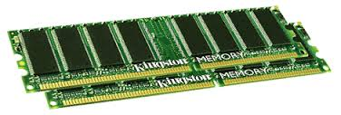
Spark Uses Memory instead of Disk
Hadoop: Use Disk for Data Sharing
HDFS
read
HDFS
Write
HDFS
read
HDFS
Write
Iteration1
Iteration2
Spark: In-Memory Data Sharing
HDFS read
Iteration1
Iteration2

Slide 40
Spark: RDD
What is an RDD?
An RDD is the fundamental data structure of Apache Spark: an immutable, distributed collection of objects that can be processed in parallel across a cluster. The name breaks down as:
Resilient :fault-tolerant; can rebuild lost data using lineage information
Distributed: data is spread across multiple nodes in the cluster
Dataset: a collection of partitioned data

Slide 41
RDD Characteristics:
1. Immutability RDDs cannot be changed once created. Any transformation produces a new RDD. This simplifies fault recovery and concurrency.
2. Lazy Evaluation Transformations on RDDs are not executed immediately. Spark builds a DAG (Directed Acyclic Graph) of transformations and only executes when an action is called.
3. Partitioning Data is divided into partitions distributed across cluster nodes. Each partition is processed independently, enabling parallelism.
4. Lineage (Fault Tolerance) Spark tracks the sequence of transformations that produced each RDD. If a partition is lost, Spark can recompute it from the original data using the lineage graph no need for replication.
5. In-Memory Computing RDDs can be persisted in memory across operations, dramatically speeding up iterative algorithms.

Slide 42
Example
sc = SparkContext()
# 1. From a collection
rdd = sc.parallelize([1, 2, 3, 4, 5])
# 2. From an external file
rdd = sc.textFile("hdfs://path/to/file.txt")
# 3. From another RDD (via transformation)
rdd2 = rdd.map(lambda x: x * 2)

Slide 43
Transformative functions
Transformation | Description
map(func) | Apply a function to each element
filter(func) | Keep elements matching a condition
flatMap(func) | Map then flatten results
reduceByKey(func) | Aggregate values by key
groupByKey() | Group values by key
distinct() | Remove duplicates
union(rdd) | Combine two RDDs
join(rdd) | SQL-style join on key-value RDDs
sortBy(func) | Sort elements

Slide 44
Actions: Trigger execution
Action | Description
collect() | Return all elements to driver
count() | Count number of elements
first() | Return the first element
take(n) | Return first n elements
reduce(func) | Aggregate all elements
saveAsTextFile(path) | Write RDD to disk
foreach(func) | Apply function to each element

Slide 45
Question
let say , in RDD, a data is updated, so new rdd with updates will be created, then what happens to the previous one?

